Slide 1
AROMATICITY
PRESENTED BY
LEELAWATI PAIKRA

Slide 2
INTRODUCTION
Aromaticity is a property of cyclic planar structure with pi bonds in resonance that gives increased stability compared to other geometric arrangements with the same set of atoms.Aromatic rings are very stable and do not break apart easily.

Slide 3
AROMATIC PROPERTIES
These are 5 or 6 membered and sometimes 8 membered cyclic substances.
The molecules of aromatic compounds are planar and cyclic.
Their bonds are cyclically delocalised.
The number of electrons present in their molecules should be as per Huckel’s rule (4n+2) .where n is an integer ( 0,1,2,3,4.....).

Slide 4
HUCKEL’S RULE
Huckel after studying many aromatic compounds,formulated a law called Huckel’s law (4n+2).
examples – benzene,napthalene,anthracene.

Slide 5
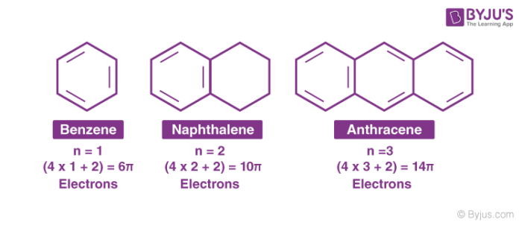
Examples of Huckel’s rule

Slide 7
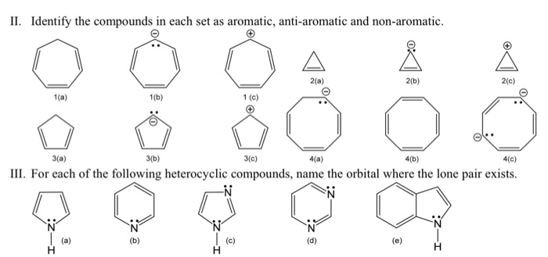
ANTIAROMATICITY

